Slide 1


KETHOLESHIIDA… DIETHERIEKO
Ketholeshiida … Dietherieko kezhakesu, Kijiipete Krothoko Fort Worth, Texas
©2006 TBBMI
Designed by Dr. John Fryman, Texas, USA • BibleBasically.org
Taught by Dr. Rick Griffith, Singapore Bible College
All files in many languages for free download at BibleStudyDownloads.org
www.biblebasically.com
©2006 TBBMI
Notes:
In THE QUICK CHRONOLOGY we found THE WHAT of what happened in the great Biblical panorama. Now it's time to discover THE WHY of those world-shaping events.

Slide 2


Bible Nu Thechu Merhi Khapie Bayakezhako
Uko krothoko Todd Boln puophouliete, kekrilamonyu Ketholeshuda nu Thichu Miarhi khapie Bayakezhako puo noumvu di uko bu Ketholeshuda Diethierieko Sebakechula. Ketholeshuda Diehierieko sekebako vodi BiblePlaces.com meho mu miarhiko pfuliechie, kekrilamonyu Ketholeshuda thenyie kezu hanu ba: Kemasa thechu vo Agean mu Medterranean thela ketso nunu vo pesotsa Europe ketso, kerapuo kepeliamia kepele mia kepele sedeklie thechu nu. BiblePlaces.com nu kepetha mu miarhi vithor kechu mu mejuliekengukechu ngulietuo.
Vodi mehoshuchie!
Npezie, Todd!
9.65.05a.
01a

Slide 3


(HAUHA LANU mha hako chii par te!)
KETHOLESHIIDA… DIETHERIEKO
®
CA 5-U
KETHOLESHII MVIIDZEU
9.65.05a.
©2006 TBBMI
02
Notes:
SEGMENT TITLE: BIBLICAL BEDROCK (A)
In THE QUICK CHRONOLOGY we found THE WHAT of what happened in the great Biblical panorama. Now it's time to discover THE WHY of those world-shaping events.

Slide 4

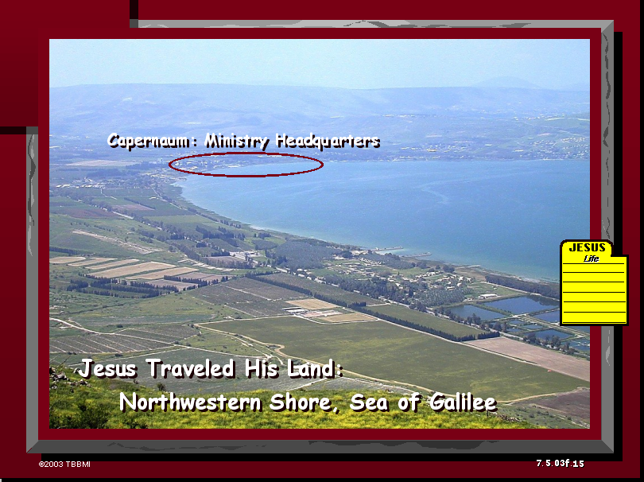
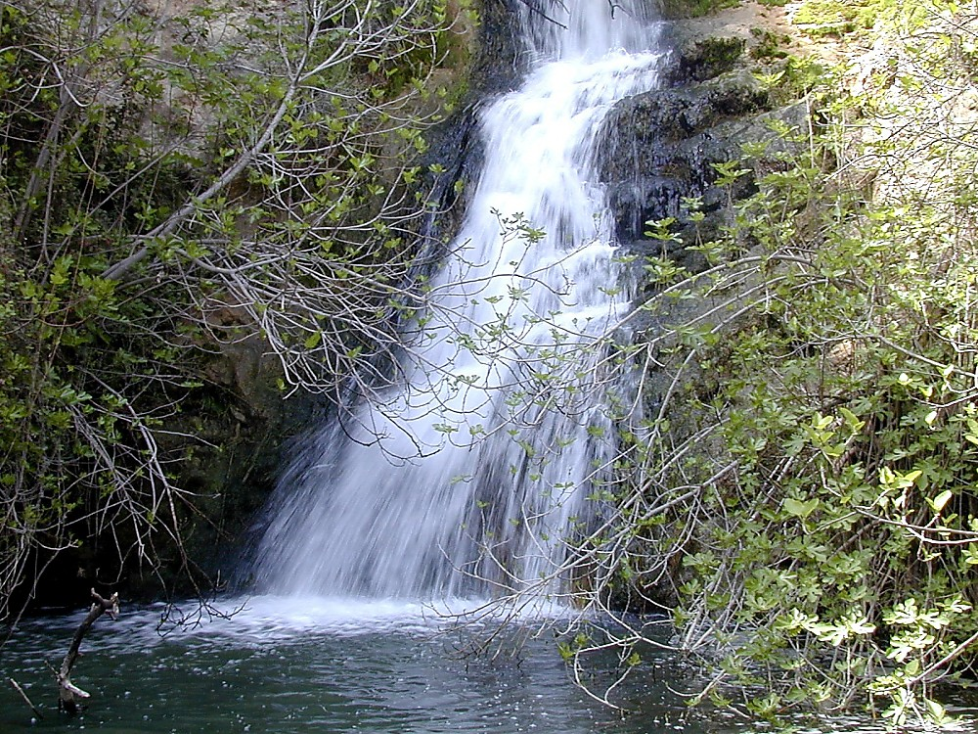
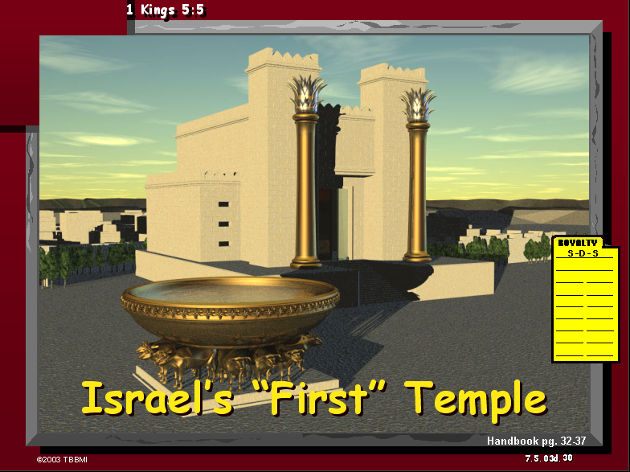
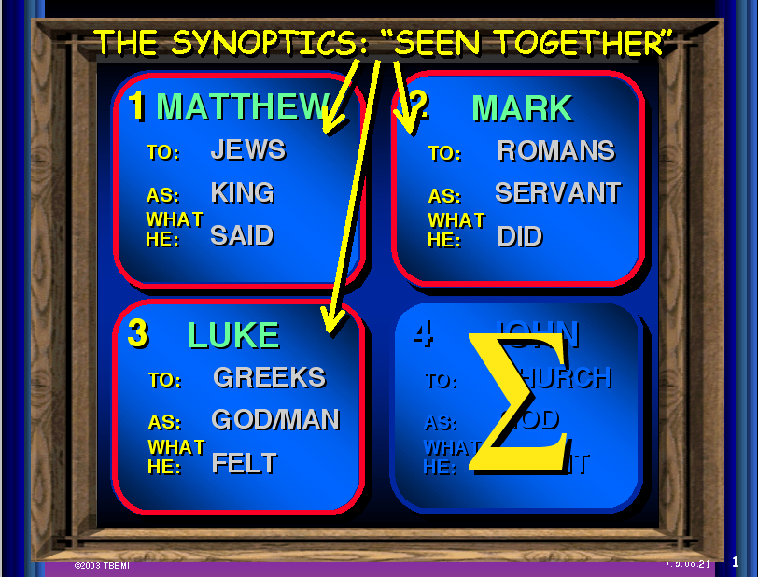
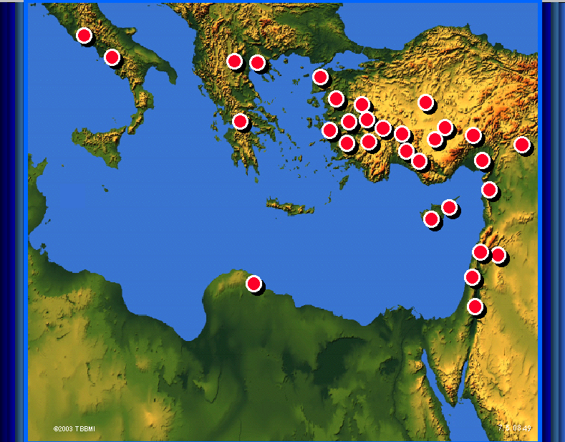
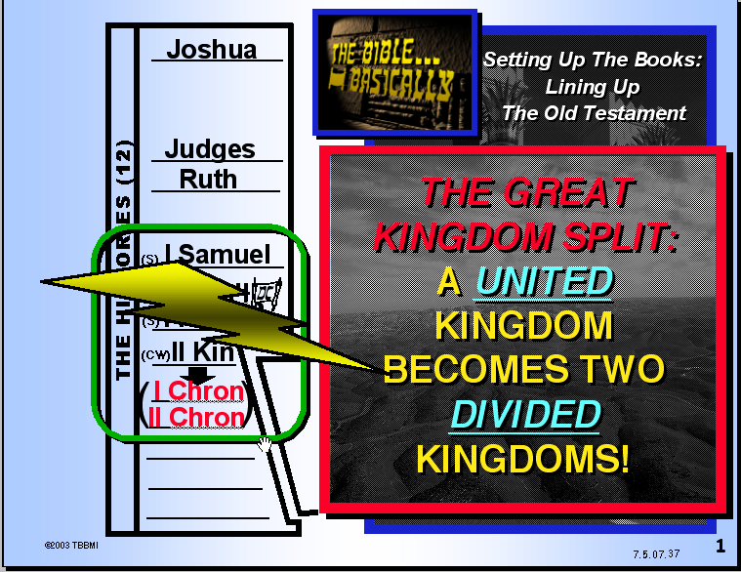
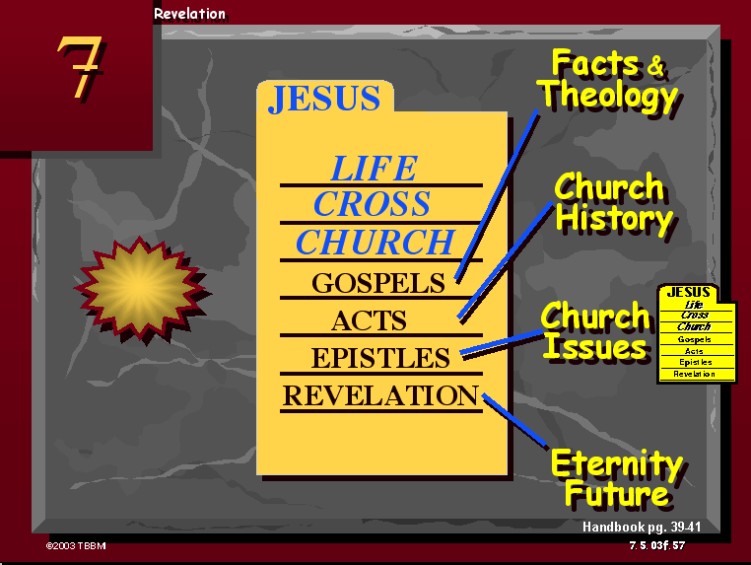
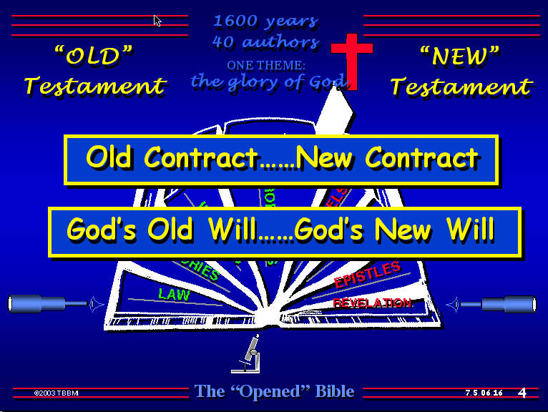
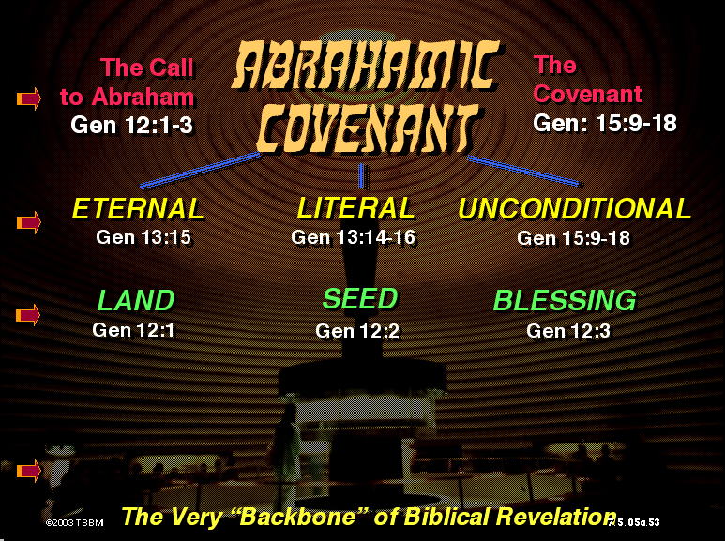
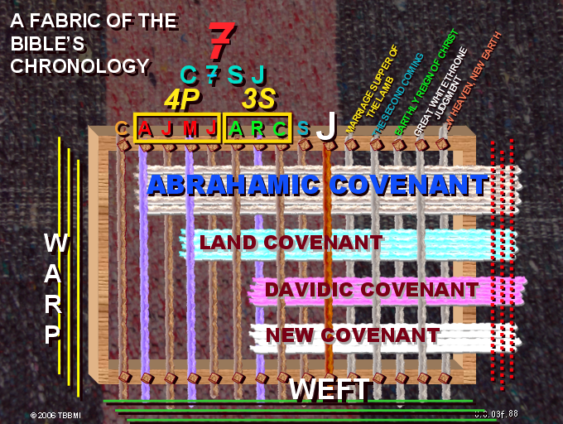
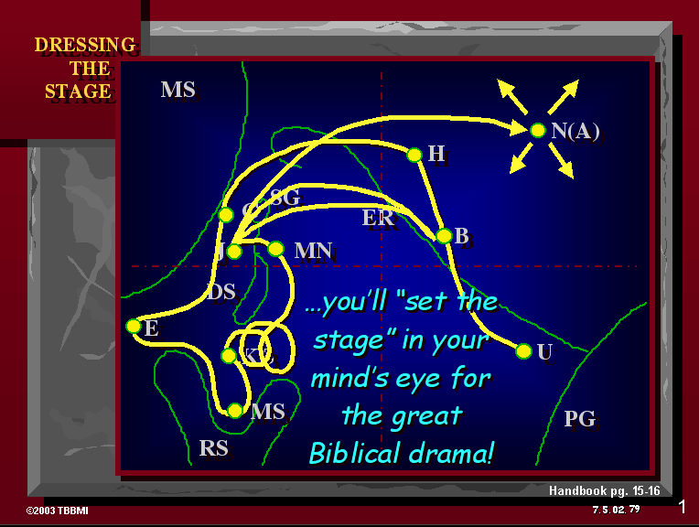
03
©2006 TBBMI
9.65.05a.
Notes:
[AUTO SLIDE MONTAGE-BLUE GRAPHIC LOWER LEFT IS THE LAST]
In everything we've encountered so far in THE BIBLE...BASICALLY, we have covered enormous epochs of time, a storyline of incredible dimension, presented to us in a collection of books that are unparalleled in divine authorship, human impact, and spiritual instruction.
So the question is this: what holds all this together? Are there concepts or basic ideas that run straight through the progress of each event and the presentation of each new revelation in God's unfolding program for Man?

Slide 5
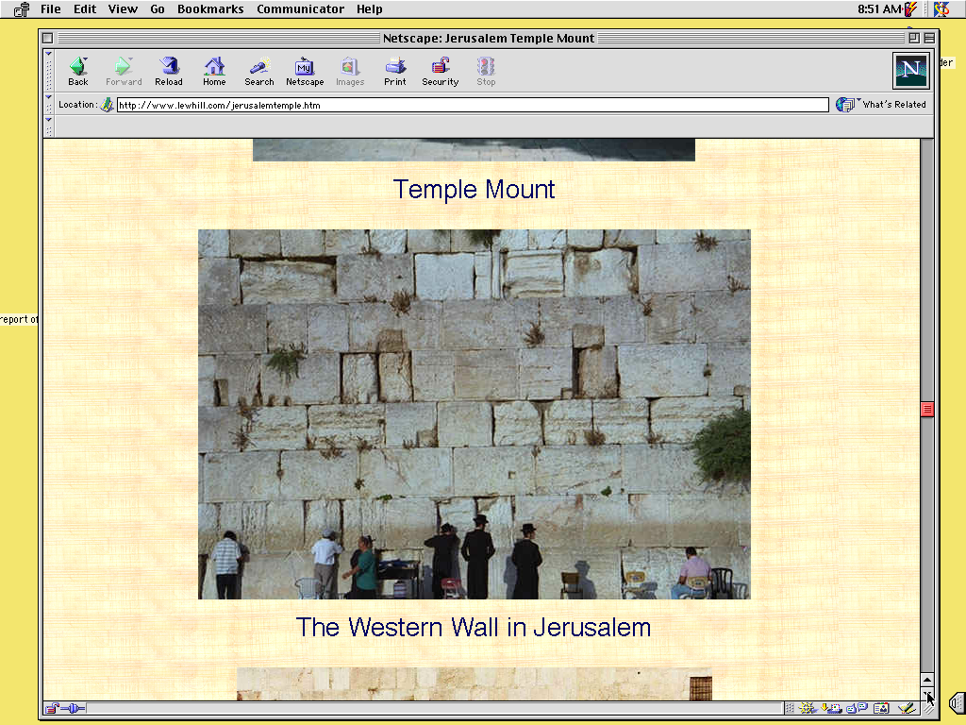
Ketholeshii
Mviidzeu
PUO
SEDE
RA NU!
9.65.05a.
1
©2006 TBBMI
04
Notes:
The answer is, yes. The ideas ARE there. And we call them, our BIBLICAL BEDROCK...because in that deepest stratum of biblical meaning, revelation and understanding...
//// ….that's where it all begins.

Slide 6



PFHE PUO DO KETUO LA KELO MEZO KEBA KEMHIE PUO LESHII KHE. . .
TEICIE-U KESEDE DI KEBA HAU KETHODIE NU PFHEPHRIE PUO KEMHIE ZO
KEPHRII KHRUOHI #08
9.65.05a.
© 2006 TBBMI
05
Notes:
Remember that imaginary loom we built and threaded in the JESUS FILE? On Study Help #8 we called it "The Fabric of the Bible's Chronology.

Slide 7
TEICIE-U KESEDE DI KEBA HAU KETHODIE NU PFHEPHRIE PUO KEMHIE ZO
7
4T
3K
J
P
A
J
M
J
K
K
K
Z
DIEBO KER KO LE SHI!
9.65.05a.
1
© 2006 TBBMI
06
Notes:
We prepared the loom with ten threads representing the C7SJ ideas…
//// …followed by those ten organizing words of THE BIBLE FILE.

Slide 8
TEICIE-U KESEDE KI KEBA HAU KETHODIE NU PFHEPHRIE PUO KEMHIE ZO
7
4T
3K
J
P
A
J
M
J
K
K
K
Z
PELHOUKESHII
ABRAHAM
JOSEF
MOSA
JOSHUA
KEBVIIKEBOUKECII
KEDIMIAKO
KEDIEKECHII
ZEIKECII
JISU
9.65.05a.
© 2006 TBBMI
07
Notes:
…CREATION, ABRAHAM, JOSEPH, MOSES, JOSHUA, ANARCHY, ROYALTY, CAPTIVITY, SILENCE, and Jesus.

Slide 9
TEICIE-U KESEDE KI KEBA HAU KETHODIE NU PFHEPHRIE PUO KEMHIE ZO
7
4T
3K
J
P
A
J
M
J
K
K
K
Z
PELHOUKESHII
ABRAHAM
PUO TEI THELA KI
JOSEF
MOSA
JOSHUA
KEBVIIKEBOUKECII
KEDIMIA
KEDIEKECHII
ZEIKECII
JISU
9.65.05a.
© 2006 TBBMI
08
Notes:
Then we added five additional threads to represent the main events of the troubling END-TIMES scenario. The vast majority of the Body of Christ agrees – at least -- on these five future events. They are…

Slide 10
TEICIE-U KESEDE KI KEBA HAU KETHODIE NU PFHEPHRIE PUO KEMHIE ZO
7
TEKUONUO KIYAKECHII HE
4T
3K
JISU KIJII NU LA TSUR DI KECII
KEDIBA KEKRA KEZHA
J
JISU LA KEVOR
TEI KESA, KIJII KESA
P
A
J
M
J
K
K
K
Z
PELHOUKESHII
ABRAHAM
PUO TEI THELA KI
JOSEF
MOSA
JOSHUA
KEBVIIKEBOUKECII
KEDIMIA
KEDIEKECHII
ZEIKECII
JISU
9.65.05a.
4
© 2006 TBBMI
09
Notes:
the marriage supper of the Lamb…
//// the second coming of Christ
//// his thousand-year reign on earth…the Millennium…
//// followed by the Great White Throne Judgment,
//// culminating in that event that climaxes them all… the New Heaven and the New Earth.

Slide 11
TEICIE-U KESEDE KI KEBA HAU KETHODIE NU PFHEPHRIE PUO KEMHIE ZO
7
4T
3K
JISU KIJII NU LA TSUR DI KECII
TEKUONUO KIYAKECHII HE
KEDIBA KEKRA KEZHA
J
TEI KESA, KIJII KESA
JISU LA KEVOR
P
A
J
M
J
K
K
K
Z
ABRAHAM DIETSIDIEKHO
KIJII DIETSIDIEKHO
DAVID DIETSIDIEKHO
DIETSIDIEKHO KESAU
9.65.05a..
5
© 2006 TBBMI
10
Notes:
Now…bring back to mind those strong bands of the covenants that we wove into that fabric of the Bible's chronology...Those covenants…unconditional promises from God…we believe are continuing to run at this very time. Those strong bands of the Old Testament promises are, in order,
//// THE ABRAHAMIC COVENANT...Genesis 12 and 15…
//// THE LAND COVENANT...Deuteronomy 30
//// THE DAVIDIC COVENANT…2 Samuel 7…and
//// the great NEW COVENANT…Jeremiah 31.
Taken together, all these grand events bring to a
//// close earth's history and the climax of all those glorious promises – and their complete fulfillment – made from God to old Abraham so long ago.

Slide 12
KETHOLESHII NU PESIKESHII “MVIIDZEU”
Kepenuopfii thepha kejii
Dietsidiekho mharhii-u
11
Notes:
SO...to further explore all this...let's get into THE BACKBONE OF BIBLICAL REVELATION...GOD'S UNCONDITIONAL COVENANTAL PROGRAM.

Slide 13
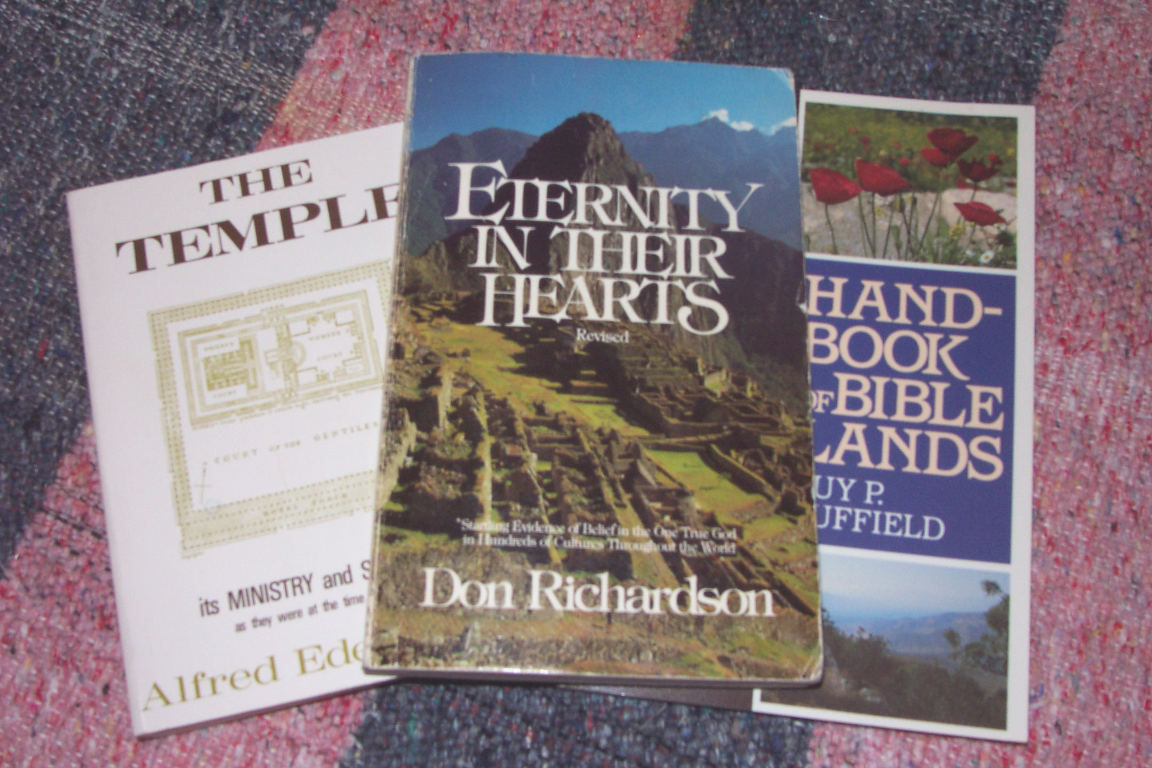
Ketholeshii nu pesikeshii mviidzeu:
Kepenuopfii thepha kejii dietsidiekho mharhii-u
Don Richardson, Eternity in Their Hearts
12
Notes:
Here's another good quote to think about...it's by Christian author Don Richardson, a writer of wide and long experience on the mission field...a missionary who is also an expert linguist. Don Richardson wrote...in his book ETERNITY IN THEIR HEARTS…

Slide 14
Ketholeshii nu pesikeshii “mviidzeu”:
Kepenuopfii thepha kejii dietsidiekho mharhii-u
Kethunuro- puo mviidze kejii kemhie zo. Hai keta sie Khristamiako-e theja ngukelieko keyie pie u tho ukrotho nu keshii-u monyii kijii nu themia pete gei shii shiituoii keba nounyii-u tsa ta tuo. (Pg. 163)
Abraham geinu dietsidiekho-u...Ketholeshii mviidzeu zo – riikrii zo di pesikeshii puo chieseiru-u. Kepethadie mviidze chieseiru hau phra kemoko chieseiru sa kemo kemhie puo thachii nyitou zotuo.
Don Richardson, Eternity in Their Hearts
13
2
Notes:
“The Abrahamic Covenant...is the very backbone of the Bible – the spinal column of special revelation. Teaching which does not acknowledge that spinal column will inevitably have a certain spinelessness about it.
//// It will – quite literally – lack backbone. And it will tend to leave Christians less motivated than they would otherwise be to …
//// …pass on the blessing they have received, not merely to their own kind of people, but to all people on earth.”

Slide 15
Ketholeshii nu Pesikeshii “Mviidzeu”:
Kepenuopfii Thepha Kejii Dietsidiekho Mharhii-u
“KEPHOUMA” Die hau mehoshii liro…
Ibri mu Grik nu:
Thezho kesuo
Kejokemou
Vajokewa
Keriizhii
Chii kesuou chii kecii
Mhakesuo...
KEPHRII KHRUOHI #10
14
8
Notes:
Now let's put some parts of a Biblical puzzle together. There will be several pieces to work with. Begin with Study Help #10.
//// Starting with some ideas about that common little English word, SIN.
//// In both the Hebrew of the Old Testament and the Greek of the New...both words which, in English, are translated SIN ... actually have much wider meanings…such as…
//// MISBEHAVIOR...
//// INIQUITY...
//// TRANSGRESSION...
//// WICKEDNESS...
//// TRESPASS...
//// and EVIL...
Each of those words in their original languages means all these different kinds of negative behavior. As you can see, the word SIN is really an ineffective single word when we consider all the wider ORIGINAL meanings for which the only English word in translation is: SIN.

Slide 16
Ketholeshii nu Pesikeshii “Mviidzeu”:
Kepenuopfii Thepha Kejii Dietsidiekho Mharhii-u
DEREI!…NO HAU LE BATUO…
“KEPHOUMA”... Die hau mehoshii liro
Ibri mu Grik nu:
…MHARHII HAU KIRAPUO BA GA?
“Mharhii-u vajokewa.”
15
2
Notes:
But there is also a phrase common to both the Hebrew and the Greek
for the word that in English is translated as SIN.
//// the phrase is...TO MISS THE MARK…even as an archer might miss the mark of the target's bull's eye.
//// But you are probably thinking…where or what in the world…in the biblical sense...is that kind of mark?

Slide 17
Ketholeshii nu Pesikeshii “Mviidzeu”:
Kepenuopfii Thepha Kejii Dietsidiekho Mharhii-u
“KEPHOUMA”…Die hau mehoshii liro
Ibri mu Grik nu: “Mharhiiu vajo kewa.”
MEZHII DI VITSEILIE KETUO SII….KETHOLESHII NU THUPIE KEZHII MEHOSHII KHE!
“Siila teigei keba nieko Puou vi tseikecii tuoi nieko rei vi tseiliechie.” Mathi 5:48
16
1
Notes:
Well…for that plumb line of perfection…we go straight to Scripture. And there we discover God's own mark or expectation for perfect human behavior.
//// Jesus Himself said, “Be perfect, therefore, as your heavenly Father is perfect.” [Matthew 5:48]

Slide 18
UKEPENUOPFII ZHAPUZAYIE ZAKO !
ABBA…THUKEPELUOU…KUOKEJOKEJIIU…ALFA…AMEN…NNHIE NU KETUO-U…
KEDAKELIEU…PETHAKELIE MU ZIEVO-U…U NIEPUU BOU…
KELHOU ZOKESHIIU…U KEPELE ZOKESHIIU…THERIE MU THELAU…
THEJAKEPFIIU MU PUO RIIBEI KEBAU…PUOCO…KERHEI NIAKHRIIDA…NIEPU NIAKHRIIDAU… YASAU…TEIZIEPFII…KUOPFHEU…KEDAKELIEU…KHRISTA…NIEPUU KHRISTAU…KHRISTA NIEPUU…KHRISTA KERHEI KEPENUOPFII NUOU… THUKEPELUOU…KEKHAYAKEZHAU…ISRAELMIA NOU THUKEPELUOU…MI CHIITHEKEWAU…CORNERSTONE…THUKEPELUOU… CHIIKESHIIU…CHIIPHRAKESHIIU…. SEYIE PETE MENGU… KIKHA…EL SHADDAI…KECHACHIE NIEPU… KECHACHIE PUOU…PUOTHO PUORHEITOUU NUNU CHII KEPFII MIAU… DIETHO MIATHO…KEMIATHO ZHAPUU…PUOU… MHAPETE PELHOUKESHII MHODZII LHOUKELIEU….NHASIKO KERIEU… BODEU…KHEZHANO KHRUOYAKEZHAKO MU KEPHOUMAMIA ZEU…UKEPENUOPFII MHA METHO KHAKESHII…NIEPUU ZAYIE…KEPENUOPFII…KUOKEJOKEJIIU KEPENUOPFII…MHA PETE NIEPU…NIEPU A MEHOYAKEZHAU…KUOPFHE KEVIU…ZIEVO KEZHA KEKHO-U…KUOPFHE KEZHAU… CHATHA…THEMO TSIIU…KEHOU TSIIU…MHA PETE NGULIEKETUO CAYIE…KECHACHIE ZIEVO…KEMESAU…ISRAELKO LA KEMESAU…KEMESA RUOPFII…U KEMERIIU …KELAKELIE KIEU…A…UKEPENUOPFII RHIU…PUO RHIU…IMMANUEL…JIHOVA…JISU…JISU KHRISTA UKO NIEPUU…CAPI…KEDIU…KECHACHIE KEDI…KEDIKO MHO KEDIU…PUOTEI PETE MHO KEDIU…UKEPENUOPFII KUOU…ADAM THELAU…THEZHO KHAKESHIIU…KRIITA… KELHOU…KIJII NU KEZIEU…RIIMOU MHIEI…RAZHA NU NYIEPOU KEZIVIU…JUDAMIA SEYIE MHO KEDIU…KERHEI KETSIE…KERHEI DZIILUO…NIEPU…UKEPENUOPFII NIEPU KEKUOU…JISU KHRISTA NIEPUU…MHA PETE MHO NIEPU…ZAYIE PETE NIEPU…NIEPUKO MHO NIEPUU…KUOKEJOKEJII NIEPUU…KEKHRIE…THENOU SUO KETUO MIAU…NIEPUU… MEDIATOR…NGUKEMEZHIE NIEPU…NAZARENE…DAVID NUOLHOUU…OMEGA…NUO PFULIU…UKO CIEKEVO KUO NUOU… UKO NOUNEU…LITHOU…UKEPENUOPFII KEKUOU… SIEDZEKESIU…CHIIKEMESAYA KEZHAU…RABBONI [KEPETHAU]…UKEPENUOPFII ZAYIEU KEZIE…RHAKELIEU…RIIKREIMIA MIU…RHEILAKESIEU MU KELHOUU…RIGHTEOUS ONE…KETSIE…DAVID MVIIU…SHARON NYIEPOU…KIJU NU KEDIKO MHO KEDIU…ISRAELKO MHO KEDIU…KELAKELIEU…ISRAEL GEINU KEDI THEPUO PAR…PUOSIU…KITUOU…N RUOPFII RIIGUO MU PEKRU SE KEBAU…KEYAU…DAVID NUOU…UKEPENUOPFII NUOU… JACOB GEINU KEPAR THEMVIIU…KEMIATHO KEMESA NUOU… KEPETHAU…KEZIE KETHO-U…KETHO-U…VINE…UKEPENUOPFII MHASI…UNGOZOCII U CHATHASHIIYA KEZHAU…DIE…NIEPU DIEU.
JISU
KHRISTA NIEPUU
KHRISTA NIEPUU
KHRISTA NIEPUU
KEPHRII KHRUOHI #11
Mary Foxwell Loeks, The Glorious Names of God
UKO MHARHIIU VAJO WA YA MO MO GA?
17
8
Notes:
With Study Help # 11…how exactly would you ever know the dimensions of “perfection?” For that…just look at the names of God right there in the Bible…names, terms and phrases that He uses in reference to Himself. That list gives us a good idea of the quality of the behavior and spiritual behavior expected of us. And, of course, among those dozens of the biblical names for God…are these…
//// ….ALMIGHTY…
//// ….COMFORTER…
//// ….FAITHFUL AND TRUE…
//// ….LAMB OF GOD…
//// ….RIGHTEOUS ONE…
//// ….TRUTH…
//// ….AND THAT NAME ABOVE ALL NAMES……CHRIST THE LORD…JESUS Himself!
These are some of the dimensions of expectation…to which none of us can compare. Then the question remains…
//// DO WE…OR DO WE NOT…MISS THE MARK? THAT'S why we need a Savior…Jesus Christ the Lord.

Slide 19
Ketholeshii nu Pesikeshii “Mviidzeu”:
Kepenuopfii Thepha Kejii Dietsidiekho Mharhii-u
“KEPHOUMA”...Die hau mehoshii liro
Suopuo-e mezhiipie kezhiiu khotso lie vi ta?
Paul-e Romiako 3:23 nu thu pevi se pie kha ba
18
1
Notes:
Another question then: WHO can measure up to such criteria? How do we live life on this planet and NOT miss that mark?
//// We have an answer to that. Paul summed it up clearly in Romans.

Slide 20
"...Themia peteko phoumate,
mu Ukepenuopfii zho keviu
tsolie mote."
19
Notes:
"FOR ALL HAVE SINNED AND FALL SHORT OF THE GLORY OF GOD." AGAIN…ALL HAVE SINNED!

Slide 21
Ketholeshii nu Pesikeshii “Mviidzeu” :
Ukepenuopfii Thepha Kejii Dietsidiekho Mharhii-u
KEWE
KESA
PHRAPIE KEZHII
DIETSIDIEKHO
PFHEKHO KELIE
KEPFHEKHO KELIE
THUPIEKEZHII
DIETSIDIEKHO
PHRAPIE KEZHII
THUPIEKEZHII
PHRAPIE KEZHII
DIETSIDIEKHO
DIETSIDIEKHO
KEPHRII KHRUOHI #12
PFHEKHO KELIE
THUPIEKEZHII
20
19
Notes:
Now comes another puzzle piece...Study Help #12…this one is a matter of some interchangeable words. Beginning with
//// WILL.....then
//// CONTRACT...followed by
//// TESTAMENT...and finally
//// COVENANT.
Each of these terms has a legal idea behind its meaning.
In fact,
//// CONTRACT and TESTAMENT are interchangeable...as are
//// TESTAMENT and WILL...then
//// WILL and CONTRACT...and finally...each one...
//// CONTRACT,
//// TESTAMENT and
//// WILL…is an interchangeable term with
//// COVENANT.
So there is an enormous amount of contractual and legal nuance brought together in these four terms. In other words, according to the dictionary, we could call the parts of our Bible...God's OLD
//// ….WILL…
//// ….COVENANT...or
//// ….CONTRACT…
In the same way…we could refer to God's New
//// ….WILL
//// ….COVENANT or
//// ….CONTRACT
Interchangeable terms that give enormous insight into the depth and breadth of God's legal arrangements with his Creation. With all these possibilities…it was the decision of earlier translators to use the older inclusive term TESTAMENT…giving us
//// OLD TESTAMENT and
//// NEW TESTAMENT.
Then...with the idea of Biblical covenants and contracts in mind...think about this…

Slide 22
Ketholeshii nu Pesikeshii “Mviidzeu”:
Ukepenuopfii Thepha Kejii Dietsidiekho Mharhii-u
THIEDZIITHO KELHOU NU DIETSIDIEKHOKO
MU
KEPFHEKHO KECII
21
Notes:
…the social or financial situations in those ancient times where covenants and contracts were a prominent part of civil discourse. As an example of ancient covenants, this situation…

Slide 23
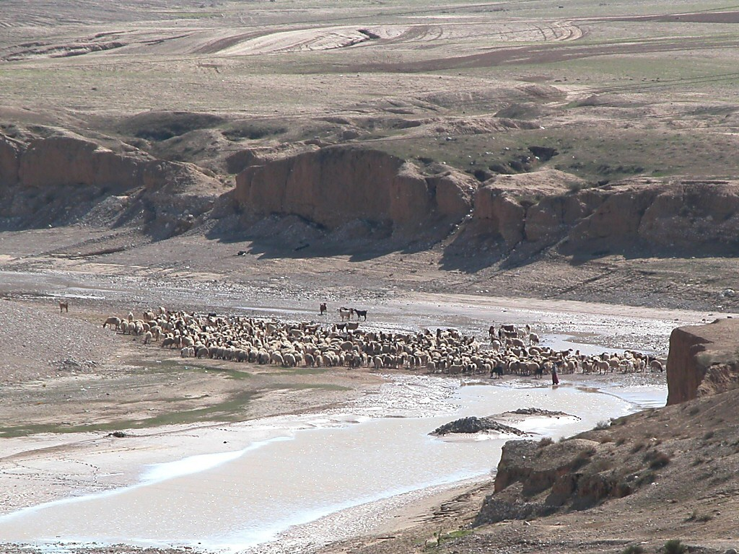
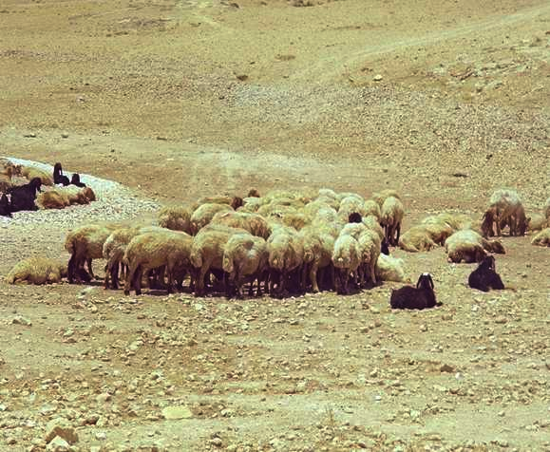
KEPHRII KHRUOHI #13
Ketholeshii nu Pesikeshii “Mviidzeu”:
Ukepenuopfii Thepha Kejii Dietsidiekho Mharhii-u
THIEDZIITHO DIETSIDIEKHOKO
22
1
Notes:
…with Study Help 13 in hand…suppose you own a herd of sheep…but you need additional land on which to graze that herd.
//// On the other hand, your friend owns a very large range of land and is quite willing to make some of it available to fill your needs.
How do you make that arrangement?
In Biblical times…in one of four ways...such as…

Slide 24
Ezra 10:19; Ezek. 17:18
Ketholeshii nu Pesikeshii “Mviidzeu”:
Ukepenuopfii Thepha Kejii Dietsidiekho Mharhii-u
THIEDZIITHO DIETSIDIEKHOKO
• U DZIE
23
Notes:
The ancient HAND COVENANT…simply shaking hands…a basic gesture of understanding between people -- coming right on down to our own time.

Slide 25
Ruth 4:8
Ketholeshii nu Pesikeshii “Mviidzeu”:
Ukepenuopfii Thepha Kejii Dietsidiekho Mharhii-u
THIEDZIITHO DIETSIDIEKHOKO
• U DZIE
• PHIKU
24
Notes:
With slightly more symbolic permanence…though temporary…the SHOE COVENANT. As a symbol of the agreement, each party exchanges a sandal, which will be retained by each...just as long as the agreement is in effect. To cancel it all, we simply give back each other's sandal, and the agreement is concluded. Things return to their original condition.

Slide 26
Lev. 2:13; Nuolhou. 18:19; Seyiedze Kenieu. 13:5
Ketholeshii nu Pesikeshii “Mviidzeu”:
Ukepenuopfii Thepha Kejii Dietsidiekho Mharhii-u
THIEDZIITHO DIETSIDIEKHOKO
• U DZIE
• PHIKU
• METSIE
• THEZIE
25
2
Notes:
Then…the SALT COVENANT…still another form of contract, this one requiring yet more commitment than the shoe covenant, though not by much. Each party to the agreement exchanged an amount of precious salt from a side condiment pouch many people carried. The idea here being that once the agreement was ended…the return of all the salt would be very difficult although, in theory, possible. And also, salt was used in ancient times as a way of ratifying an agreement. Sometimes the pouches were just exchanged between the parties. So, this contract could be nullified with some ease.
//// But now, we come to the most important and far-reaching ancient covenant or contract agreement of them all. This one we call a BLOOD COVENANT.
The Blood Covenant worked like this:
//// each of the parties to an agreement selects an animal, or animals, depending upon one's personal wealth.

Slide 27

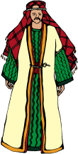

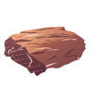

Keriekitho 15
Ketholeshii nu Pesikeshii “Mviidzeu”:
Ukepenuopfii Thepha Kejii Dietsidiekho Mharhii-u
THIEDZIITHO DIETSIDIEKHOKO
Ukepenuopfiie puothuo zo tsur di Abraham ze puozho nunu dieko chiiwa. Ukepenuopfii ki kezha 'riise' (Dietsidiekho mvii kemetei kewa) shiilie ketuo bakemo la puothuo riise was (Ibri. 6:13). Puoca kekrei nu haue-e pedekejii ze dietsidiekho chiikelieu zo. Siila die phrapie kezhiiko dietho tsei zo.”
Walvoord/Zuck, The Bible Knowledge Commentary
“THEZIE SE DIETSIDIEKHO KECHII”: “U ZA RU” KESHII NIE MIAPUO SIATA KEMOCHIE HAU HA PUOREI VAJO WA LIE KENJII!
X
• THEZIE
26
3
Notes:
The animals are slaughtered and the carcasses spread about on the ground with a passage between them,
//// …and then side-by-side, the parties walk together between the animal pieces. Significant? Yes…because blood has been spilled in behalf of the arrangement.
//// That BLOOD COVENANT then is utterly binding until the death of one of the parties! In other words, there is no abrogating a blood covenant. Why this emphasis? Here's a glimpse of that climactic scene in Genesis between Abraham and God:
//// “[God] came down and made…or literally CUT…a formal treaty with Abraham (the Abrahamic Covenant.) Since God could “swear” (confirm a covenant) by none greater, 'He swore by Himself' (Heb. 6:13). In other words this was a unilateral covenant. So its promises are absolutely sure.

Slide 28



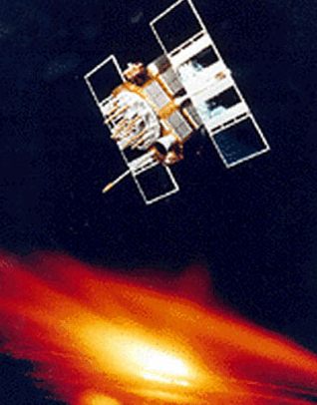
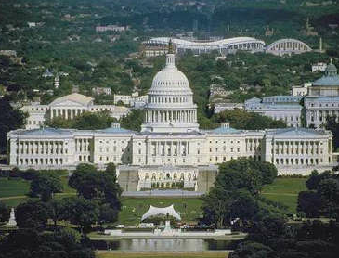

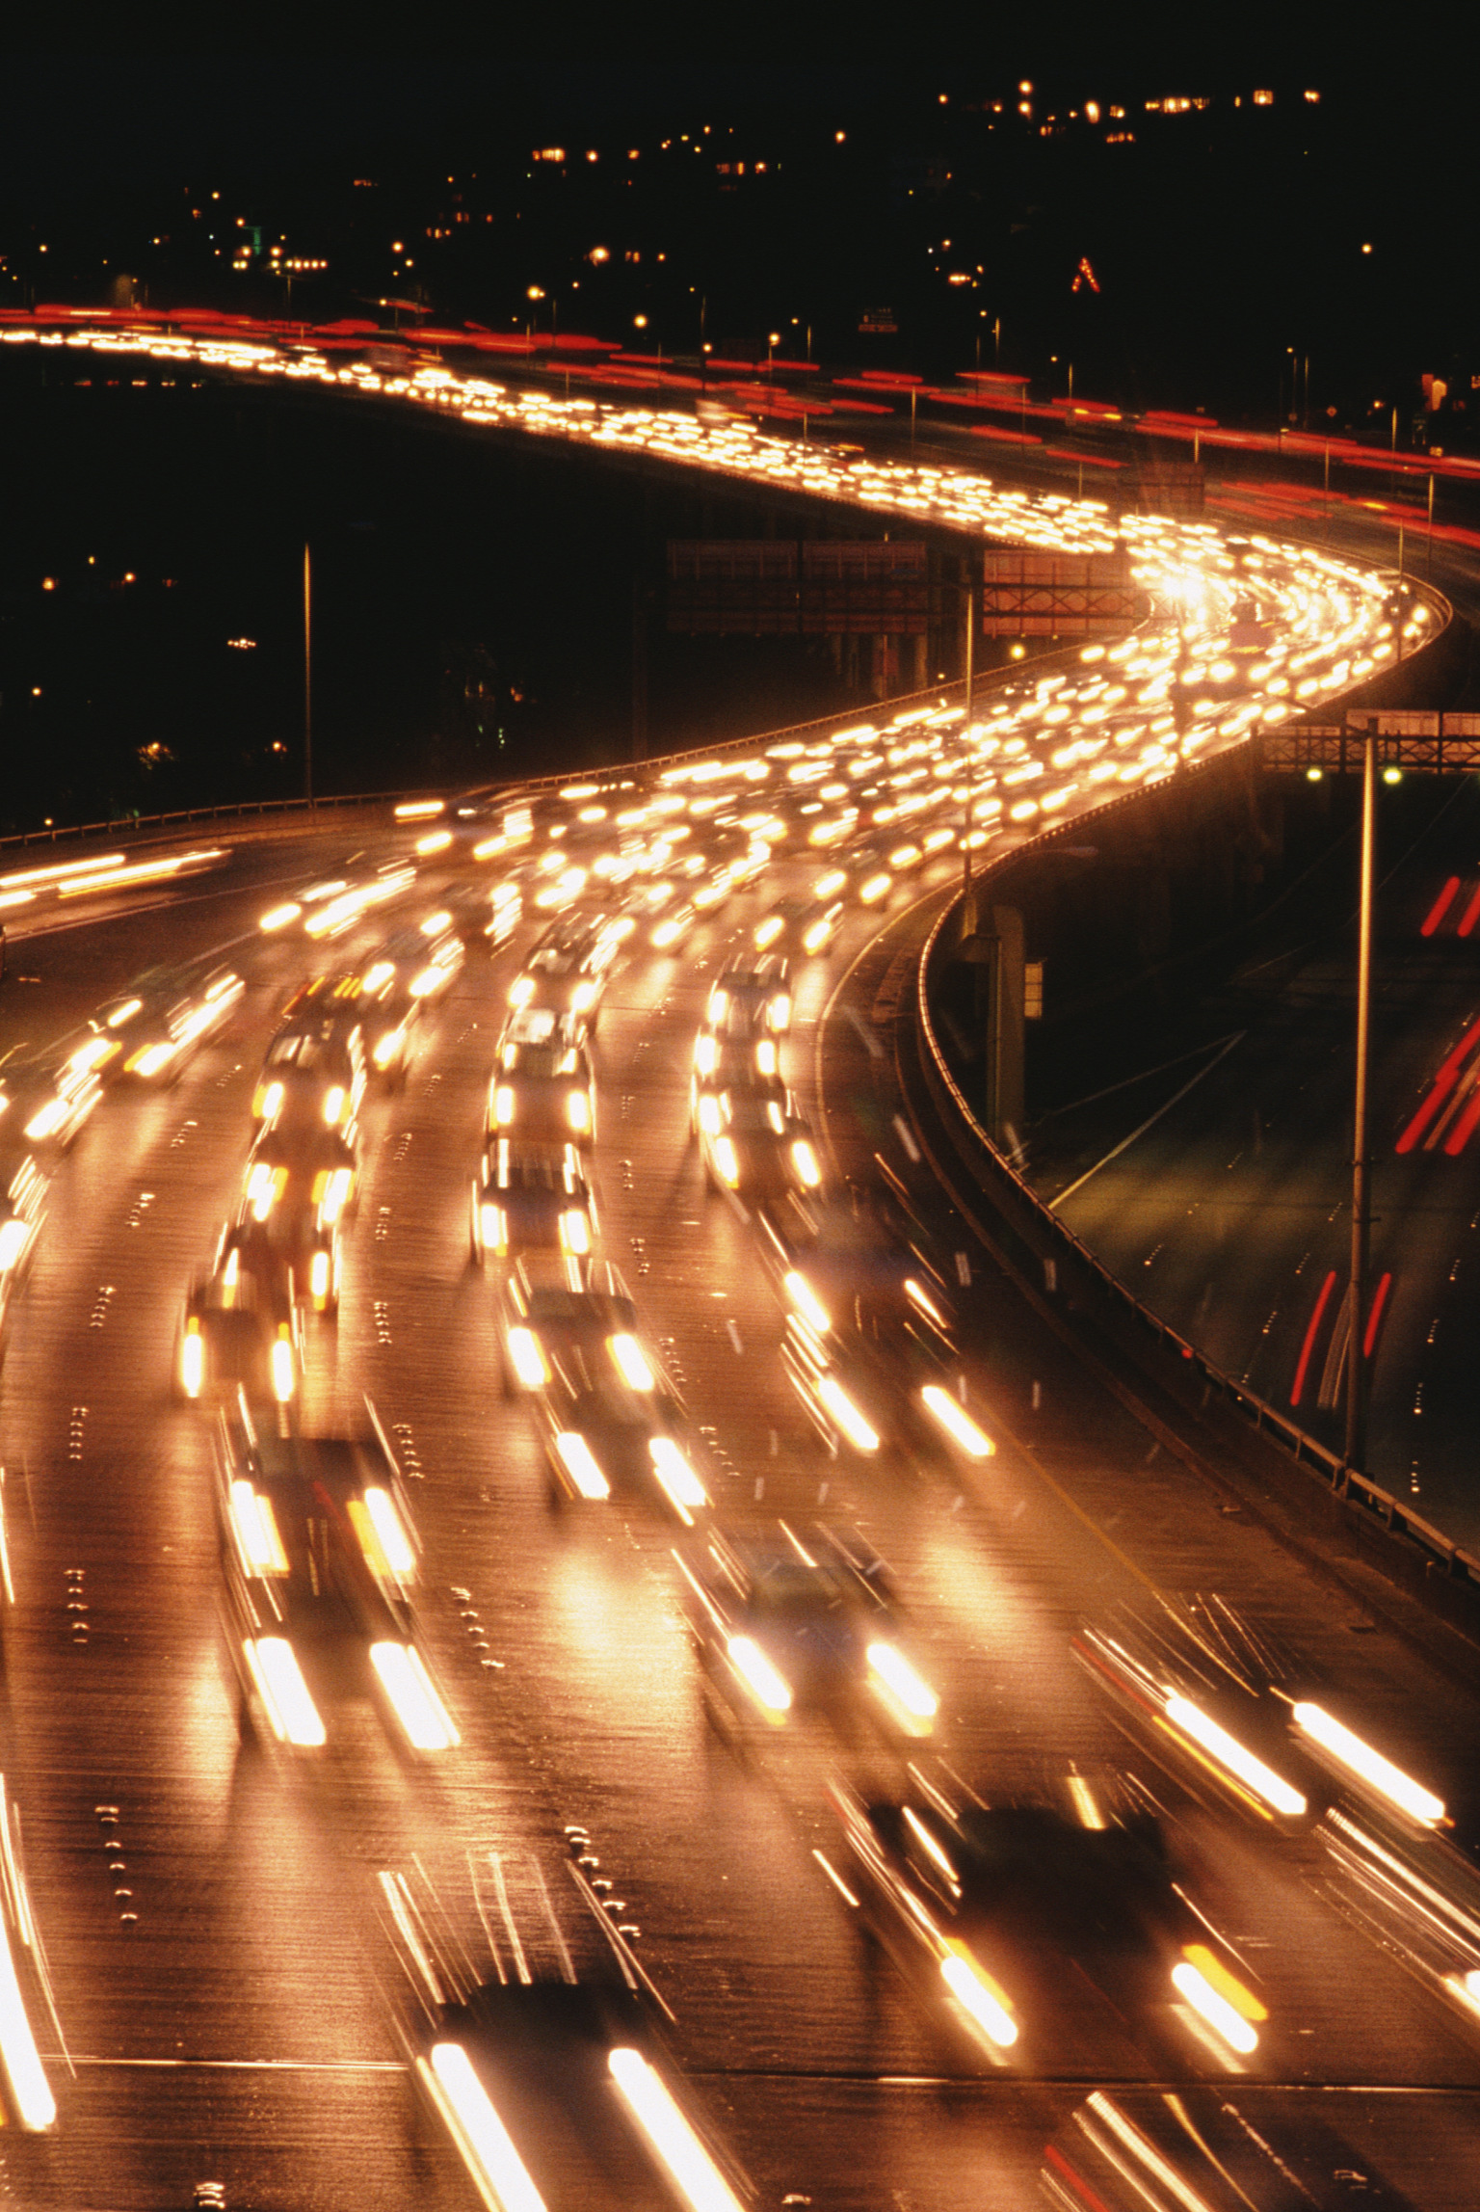
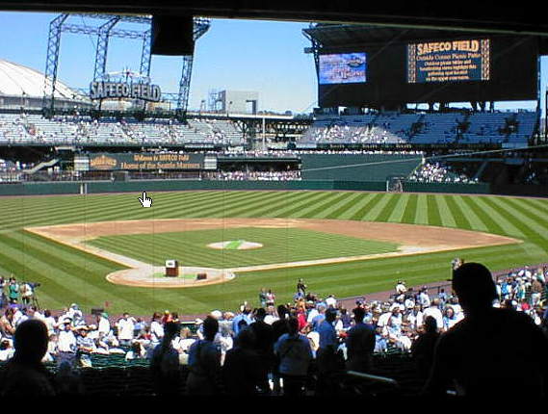
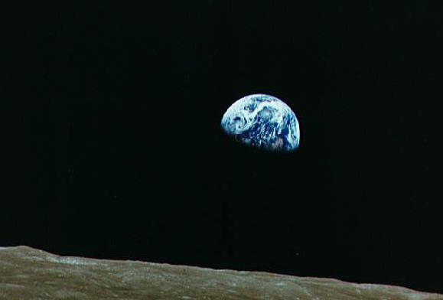
MHA HAKO PETE KEDIPUOE KEKHAKERE SE BA GA?
27
1
Notes:
Now the last puzzle piece...
Here is a series of sights and events that are common to life in the United States at this time in the world's history.
….And the majesty of the U.S. capitol building in Washington D.C.
With all of these varied aspects of our contemporary life...
//// ….there is a question here: is there one common concept that holds all this together? Is there an underlying idea or fundamental principle that brings all this – in this instance, the United States of America – together in what we could call –– in this case –– nationhood?

Slide 29
U.S. YEHZHABO
Amerikamia Kelhou Mviidzeu
28
Notes:
We could suggest that the U.S. Constitution be considered as the very BACKBONE of American life. It is a legal document...not a divine instrument, of course. However, through the centuries that single written document has held the United States and its way of life together…through war and through peace...the good times and the very bad…a document of common understanding among all American people.

Slide 30
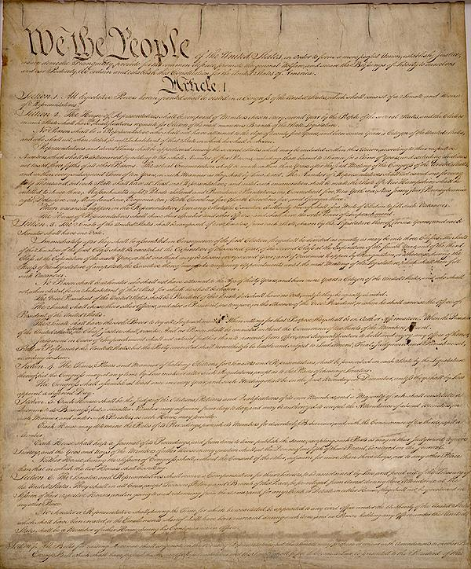
PUO THEMIAKO MU SORKARI UNIE DONU KEPFESI PIE KEZHII THEZHO LESHII-U!
U.S. YEHZHABO Amerikamia Kelhou Mviidzeu
29
1
Notes:
//// A LEGAL DOCUMENT OF UNDERSTANDING BETWEEN MEN AND THEIR GOVERNMENTS.

Slide 31
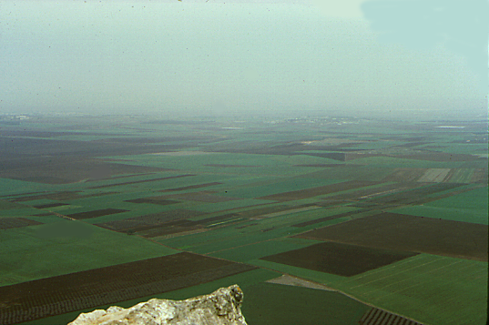
Abraham KEKIE
KADESH BARNEA
S - D - S
40
DIELIEKEVIKO
LESHIITHUKESHIIKO
SINAI
JERICHO
KIJII KEZAKEWA
430
TUOKEPRA
KEHOU
TEICIE 70
ISRAEL
SIEDZEKESIKO
J - E
MHAKECHIIKO
MIADIEMIA
CHAPIMIAKO
JUDAH
350
K - P - T
I - I
PESIKESHII
SEYIE 12
M - C - C
Z - E - N
KEPETHADIE 5
CHA 3...
9.65.05a.
© 2006 TBBMI
30
Notes:
Now think about all of these Biblical concepts, these ideas, the people, the events...all of them major parts of THE BIBLE…BASICALLY and THE QUICK CHRONOLOGY … the Bible's time and story lines we have moved through earlier…[DISSOLVING DIRECTLY INTO…]

Slide 32
The CALL
KADESH BARNEA
S - D - S
GOSPELS
40
SINAI
EPISTLES
JERICHO
LAND DIVIDED
430
MU...
EXODUS
CHURCH
70 YEARS
KEPENUOPFII JISU KHRISTA ZHAPU MHATHO
ISRAEL
PROPHETS
J - E
ACTS
SLAVERY
JUDGES
JUDAH
350
L - S - B
I - I
REVELATION
12 TRIBES
M - C - C
Z - E - N
5 SERMONS
3 TREKS...
9.65.05a.
© 2006 TBBMI
31
Notes:
…including and culminating in the ministry of the Lord Jesus Christ! Now comes another question…

Slide 33
The CALL
KADESH BARNEA
S - D - S
GOSPELS
40
SINAI
EPISTLES
MU...
JERICHO
LAND DIVIDED
KEPENUOPFII JISU KHRISTA ZHAPU MHATHO KO
430
EXODUS
CHURCH
70 YEARS
ISRAEL
PROPHETS
J - E
ACTS
SLAVERY
JUDGES
JUDAH
350
L - S - B
HAKEMHIE DI MHACHII KEPAR KO PETE NU KEKHE-KEPERO KECII BAME?
I - I
REVELATION
12 TRIBES
M - C - C
Z - E - N
5 SERMONS
3 TREKS...
9.65.05a.
© 2006 TBBMI
32
Notes:
Is there here, also, a connection, a combining principle, or perhaps even A LEGAL DOCUMENT that would account for the Biblical events unfolding exactly as they did across the pages of Scripture? Of course, there is!

Slide 34
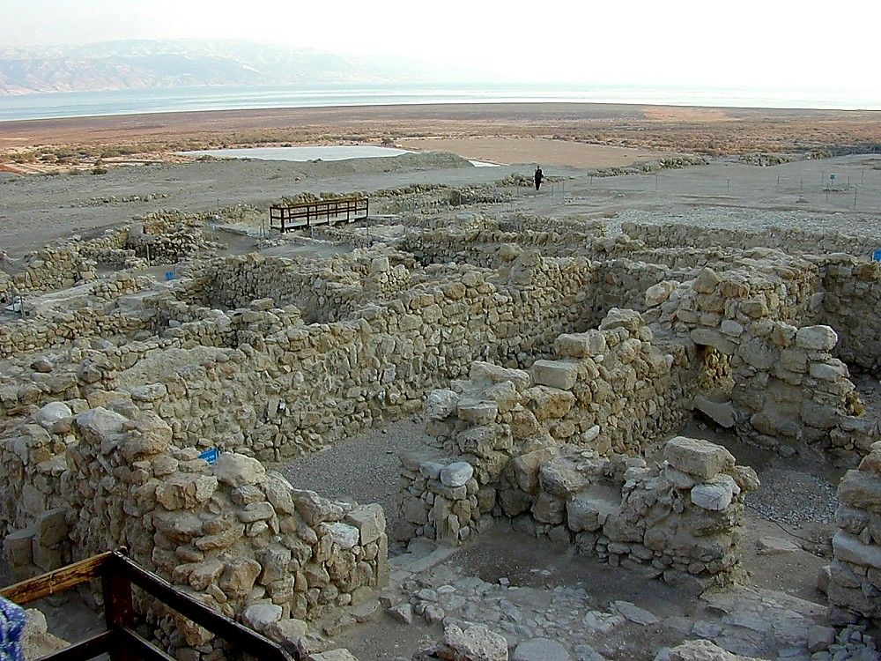
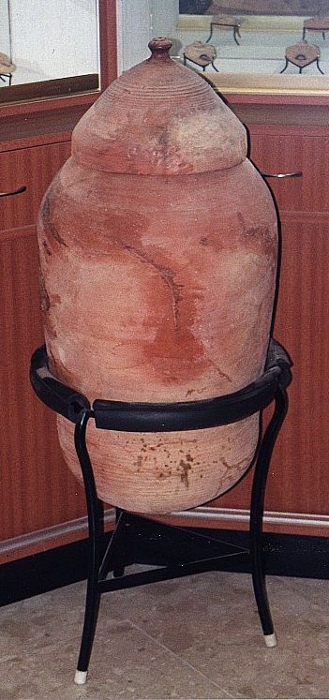
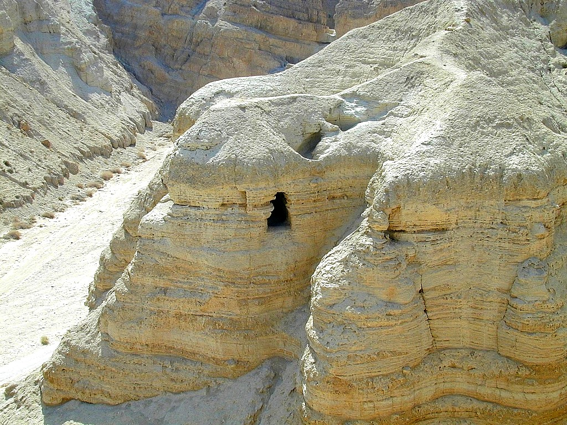
KESIA DZIIKEZHA LESHIIDAKO KEVIE
PIE KEBA
THIEDZIITHO PEKAKEWA QUMRAN RIINAU, KESIA DZIIKEZHA KHIE NU KEMESA SEYIE PUO.
33
2
Notes:
But first…let's make a framework in which to talk about all this. These are the ancient ruins of Qumran, a community of Essenes – a sect of extremely pious Jews – who lived apart on the shores of the Dead Sea not far from Jerusalem. Some scholars believe that John the Baptist was a member of this community.
//// The Essenes were known to have hand-copied the ancient Jewish scriptures. As Palestine was collapsing under the Romans, the Essenes spirited their precious copies of the Scriptures out of the community…hiding them across a dry streambed in a group of caves…
//// …preserving them in ceramic jars like this. And they stayed right there –– in the caves –– undisturbed until 1947 when they were discovered by a shepherd boy searching for his wandering sheep.

Slide 35

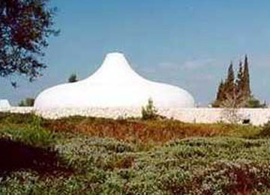

Keriisuoki Leshiidau,
Israel National Museum, Jerusalem, Israel
9.65.05a.
2
©2006 TBBMI
34
Notes:
Today, some of those ancient scrolls are preserved and displayed to the public in Jerusalem's…
//// …famed Shrine of the Book at Israel's National Museum.
//// So…from the caves…to the museum and to scroll researchers around the world…an enormous treasure of Essene writings has survived….held by many to be the most significant archeological discovery of the Twentieth Century.

Slide 36
Keriisuoki Leshiidau,
Israel National Museum, Jerusalem, Israel
Keriisuoki Leshiidau puonou nu
9.65.05a.
©2006 TBBMI
35
Notes:
Then…with this background inside Jerusalem's Shrine of the Book, let's explore the place of the Biblical legal understandings and promises between God and man…just as they have come down to us IN WRITING and preserved in the pages of Scripture in your own Bible.

Slide 37
ABRAHAM GEINU
DIETSIDIEKHO-U
KEPHRII KHRUOHI #14
9.65.05a.
1
©2006 TBBMI
36
Notes:
The arrows on the side of the screen will guide us through Study Help #14…
//// ….as we develop…first… THE ABRAHAMIC COVENANT.

Slide 38
ABRAHAM GEINU
DIETSIDIEKHO-U
Ketholeshii nu Pesikeshii “Mviidzeu”:
Kepenuopfii Thepha Kejii Dietsidiekho Mharhii-u Hanu Nu Sede. .
9.65.05a.
©2006 TBBMI
37
Notes:
This is Richardson's “VERY BACKBONE OF BIBLICAL REVELATION.” GOD'S UNCONDITIONAL COVENANTAL PROGRAM BEGINS RIGHT HERE!
That great ABRAHAMIC COVENANT....God's unconditional covenantal program of the ages was announced in two parts..

Slide 39
Abraham
Kekie Kerie. 12:1-3
Dietsidiekho-u Kerie.: 15:9-18
ABRAHAM
GEINU DIETSIDIEKHO-U
Ketholeshii Nu Pesikeshii “Mviidzeu”:
Kepenuopfii Thepha Kejii Dietsidiekho Mharhii-u Hanu Nu Sede.
9.65.05a.
2
©2006 TBBMI
38
Notes:
Guided on the Study Help by the arrows to the left…
The Abrahamic Promises originate in two different locations in Genesis...
//// First…Abraham received his famous CALL –– with its three promises –– in Genesis 12:1-3. Remember the time frame: about 2000 B.C.
//// Later on in Genesis 15:9-18, the actual Covenant is presented …in the form of a BLOOD COVENANT…as we described earlier…. followed by God –– in effect –– signing the actual COVENANT or contract between Himself and Abraham.
So then…what ARE the features of that ancient promise.

Slide 40
Keriekitho 12: 1-3
ABRAHAM GEINU CHIITUOII DI PHRAPIE KEZHII
¹ Siro Jihova-a Abram iise,
“no n kijii mu seyieko, mu n puo
n ki khawa di a kijii puo thashii n
kieketuou nu votaliechie.
KIJII
PUOSI
²“Sitse a n chiipie n bu seyie kezha
puo chiishiituo, mu a ja n tsiituo, tsiu
n za chii pezhashiituo; mu no
mia la theja puo chiilietuo.
ABRAHAM
The CALL
K - P- T
I - I
³ Siro a japie ja n ketsiimia tsiituo,
mu a n keriisemia riisetuo: mu
n geinu kijii nu seyie
pete bu theja ngulietuo.”
J - E
12
THEJA
39
8
Notes:
Read along with this Covenant between God and Abraham as we touched on it much earlier...remember from Genesis 12: 1-3?
//// ….the L-S-B on the ABRAHAM File Folder. The verses read…
//// ¹ “ The Lord had said to Abram,
“Leave your country, your people and your father's household, and go to the land I will show you.
//// THIS IS THE PROMISE OF A LAND FOR THE ABRAHAM'S DESCENDANTS.
//// ²“I will make you into a great nation
and I will bless you;
I will make your name great,
and you will be a blessing.
//// THIS IS THE PROMISE OF A SEED, OR GREAT LINE OF DESCENDANTS, TO COME FROM HIM.
//// ³ I will bless those who bless you,
and whoever curses you I will curse;
and all peoples on earth
will be blessed through you.”
//// THIS IS THE BLESSING, THAT PART OF THE PROMISE THAT EXTENDS FAR BEYOND ABRAHAM'S LINE…OUT TO EVERY PERSON ON EARTH FROM THEN UNTIL THIS VERY DAY!
//// The significant points of that promise are these... L…S…B… presenting to Abraham
A LAND...A SEED......AND A BLESSING!

Slide 41
Abraham Kekie Kerie 12:1-3
ABRAHAM GEINU DIETSIDIEKHO-U
Dietsidiekho-u Kerie: 15:9-18
KIJII
PUOSI
THEJA
Kerie 12:1
Kerie 12:2
Kerie 12:3
Ketholeshii Nu Pesikeshii “Mviidze-u”
9.65.05a.
2
©2006 TBBMI
40
Notes:
So…in outline…The LAND provision is stated in Genesis 12:1...
//// The SEED aspect laid out in Genesis 12:2...
//// And that world-girdling BLESSING provision in Genesis 12:3.

Slide 42
Genesis 12: 1-3
THE ABRAHAMIC PROMISES
¹ “ The Lord had said to Abram,
“Leave your country, your people and your father's household, and go to the land I will show you.
²“I will make you into a great nation
and I will bless you;
I will make your name great,
and you will be a blessing.
³ I will bless those who bless you,
and whoever curses you I will curse;
and all peoples on earth
will be blessed through you.” (NIV)
Die hako va puo meholashii tuo khe…
41
Notes:
Now take another quick look at those astonishing verses one more time. Two questions arise...

Slide 43
Genesis 12: 1-3
THE ABRAHAMIC PROMISES
¹ “ The Lord had said to Abram,
“Leave your country, your people and your father's household, and go to the land I will show you.
²“I will make you into a great nation
and I will bless you;
I will make your name great,
and you will be a blessing.
³ I will bless those who bless you,
and whoever curses you I will curse;
and all peoples on earth
will be blessed through you.” (NIV)
We die hako chazou ziengu nunu leta ya me?
42
Notes:
FIRST… do we take them at their absolute face value…exactly what they say or mean?

Slide 44
Keriekitho 12: 1-3
ABRAHAM GEINU CHIITUOII DI PHRAPIE KEZHII
¹ Siro Jihova-a Abram iise,
“no n kijii mu seyieko, mu n puo
n ki khawa di a kijii puo thashii n
kieketuou nu votaliechie.
²“Sitse a n chiipie n bu seyie kezha
puo chiishiituo, mu a ja n tsiituo,
tsiu n za chii pezhashiituo; mu no
mia la theja puo chiilietuo.
³ Siro a japie ja n ketsiimia tsiituo,
mu a n keriisemia riisetuo: mu
n geinu kijii nu seyie
pete bu theja ngulietuo.”
43
Notes:
We are told plainly enough…God is promising Abraham and his descendants A LAND OF THEIR OWN…A GREAT NATION OF INDIVIDUALS…AND, THROUGH HIM, AN EVENTUAL BLESSING TO ALL FAMILIES OF THE EARTH!

Slide 45
Keriekitho 12: 1-3
ABRAHAM GEINU CHIITUOII DI PHRAPIE KEZHII
¹ “ The Lord had said to Abram,
“Leave your country, your people and your father's household, and go to the land I will show you.
²“I will make you into a great nation
and I will bless you;
I will make your name great,
and you will be a blessing.
³ I will bless those who bless you,
and whoever curses you I will curse;
and all peoples on earth
will be blessed through you.” (NIV)
Die hako thierei,Abraham teiki kemhie di puotou mu puoca nyi ba zome?
Mhanu…SIMOIIRO…Ketholeshii nu thupie keba mhakikecii kro puo thie puotoumo morei puoca tuo mote, isi tuo ga?
44
1
Notes:
Are these words as valid today as they were in Abraham's time
…some 4,000 years ago when first revealed to the patriarch?
Of course, that's for you to answer…from your heart and from your intellect! Our response to that question has deep implications for our faith in the infallibility of God's Word…because…
//// Otherwise…IF NOT…what other parts of the biblical record would you put aside as no longer valid…or adjust to your more comfortable preferences?

Slide 46
Keriekitho 12: 1-3
ABRAHAM GEINU CHIITUOII DIE PHRAPIEKEZHII
¹ “ The Lord had said to Abram,
“Leave your country, your people and your father's household, and go to the land I will show you.
²“I will make you into a great nation
and I will bless you;
I will make your name great,
and you will be a blessing.
³ I will bless those who bless you,
and whoever curses you I will curse;
and all peoples on earth
will be blessed through you.” (NIV)
SI-II RO… MHAKEKREI KRO PUO HAKIHA PUOCA NYI THA ME ?
U!
45
1
Notes:
A second question then follows: is there anything else at work here? Indeed…
//// Emphatically YES!

Slide 47
Abraham Kekie Kerie 12:1-3
ABRAHAM GEINU DIETSIDIEKHO-U
Dietsidiekho-u Kerie 15:9-18
KECHACHIE
Kerie 13:15
KIJII
PUOSI
THEJA
Kerie 12:1
Kerie 12:2
Kerie 12:3
Ketholeshii Nu Pesikeshii “Mviidzeu”
9.65.05a.
©2006 TBBMI
46
Notes:
The scholars, the linguists and the teachers tell us that these words are ETERNAL in their application...an example is Genesis 13:15. Are these words in effect even as you read them here?

Slide 48
KECHACHIE...Keriekitho 13:15
¹⁵No kijii kengu kheko a khapie no mu n seyieko tsii zotuo.
47
1
Notes:
God said..."All the land that you see I will give to you and your offspring FOREVER."
…Not a year...or a thousand years...but FOREVER…an unmistakable meaning in the Hebrew original.

Slide 49
Abraham Kekie Kerie 12:1-3
ABRAHAM
GEINU DIETSIDIEKHO-U
Dietsidiekho-u Kerie 15:9-18
KECHACHIE
PUOCAIIU
Kerie 13:15
Kerie 13:14-16
KIJII
PUOSI
THEJA
Kerie 12:1
Kerie 12:2
Kerie 12:3
Ketholeshii Nu Pesikeshii “Mviidzeu”
9.65.05a.
©2006 TBBMI
48
Notes:
Following ETERNAL…then…the covenant promises are LITERAL. They mean exactly what they say.

Slide 50
PUOCAIIU...Keriekitho 13:14-17
¹⁴Siisie Lot puo kinu tuoketa sie Jihova Abram iise, “No n tha nunu to sie pesotsa, pekhrotsa, niathutsa mu niakhratsa mehoshiichie.
49
Notes:
Look at the larger context of that FOREVER verse…Genesis 13: 14-17.
"The LORD said to Abram after Lot has parted from him, "lift up your eyes from where you are and look north and south, east and west.”

Slide 51
¹⁵No kijii kengu kheko a khapie no mu n seyieko tsii zotuo.
PUOCAIIU...Keriekitho 13:14-17
50
Notes:
All the land that you see I will give to you and your offspring forever.

Slide 52
¹⁶Mu a n tsie chiipie kijii nu nyophe tuoi shiituo: sidi mia puonie kijii nu nyopheko phrii lievi ro, n seyieko rei phriilietuo.
PUOCAIIU...Keriekitho 13:14-17
51
Notes:
I will make your offspring like the dust of the earth, so that if anyone could count the dust, then your offspring could be counted.

Slide 53
¹⁷Sieliechie, di tuose kijiiu puo cha puo zha ze voshiichie;
a siiu kha n tsii bei zotuochii la.”
PUOCAIIU...Keriekitho 13:14-17
52
1
Notes:
Go, walk through the length and breadth of the land, for
I AM GIVING IT TO YOU.

Slide 54
Abraham Kekie Kerie 12:1-3
ABRAM
GEINU DIETSIDIEKHO-U
Dietsidiekho-u Kerie 15:9-18
KECHACHIE
PUOCAIIU
THEPHA KEJII
Kerie 13:15
Kerie 13:14-16
Kerie 15:9-18
KIJII
PUOSI
THEJA
Kerie 12:1
Kerie 12:2
Kerie 12:3
Ketholeshii Nu Pesikeshii “Mviidzeu”
9.65.05a.
©2006 TBBMI
53
Notes:
Underlying every word of this additional information on the contract is the fact that God is giving the land – making the promises -- to Abraham and his descendants with no strings attached. In other words...it is an UNCONDITIONAL COVENANT arrangement. What does that imply… UNCONDITIONAL?

Slide 55
  MHARHII CAII KEMEYIE
  KENIE...
THEPHA KEBA PFEKHODIE...
“NO LOUU CHIISHII RO…
A HAU CHIISHIITUO.”
THEPHA KEJII PFEKHODIE...
“N THUO CHIISHIE MO SHIEREI, A WE HAU MOREI LOUU CHIISHIITUO.”
54
5
Notes:
Think of these two crucial formulas:
//// A CONDITIONAL agreement would be...
//// "I will do THIS...if you will do THAT."
It's an agreement requiring mutual action on both sides of a bargain or agreement.
//// However, for an UNCONDITIONAL agreement to be arranged,
the formula must be…
//// "I will do this or that NO MATTER WHAT YOU MIGHT DO in the meantime."
It's an agreement between two parties with one side of the agreement carrying out its end of the deal with absolutely nothing required – no action whatever -- on the part of the other.
//// THAT was and is the very heart and soul of the Abrahamic Covenant, Contract, Testament, or...in this case, God's Will.

Slide 56
THEPHA KEJII...
Keriekitho 15:9-18*
¹⁷Siisie niaki leta di tei zeita tse, harie, mikhu mi-ii puo, mu mitu puo chii khrieko donu vota.
*Hauha thezie se dietsidiekho chiikelie pekieshii
55
2
Notes:
Now…for an event closer look…we'll read Genesis 15: 9-18:
//// It's the scene of that blood covenant agreement between God and Abraham. Here are two verses at the climax of the scene of signing the blood covenant –- a recognized legal contract in the culture of that day:
//// “When the sun had set and darkness had fallen, a smoking firepot with a blazing torch appeared and passed between the pieces.

Slide 57
THEPHA KEJII...
Keriekitho 15:9-18*
¹⁸Siinhiesii JIHOVA Abram ze kediekhokelie, puo iise, “A Ijipt kerii nunu vo kerii kezhau Eufrat ketso kijii hau kha n tsiiwate...”
56
Notes:
“On that day the Lord made a covenant with Abram and said, "To your descendants I give this land, from the river of Egypt to the great river, the Euphrates."

Slide 58
Khinhyii kepu kemhie,Abraham la nu thezie se dietsidiekho chiipie ketuoe Kepenuopfii puo thuo puo mu puo kezeu Abraham kitsatie unie donu tuoii di phrapie kezhii pfekho dieu zo.
Ibriko 6
¹³Siro Ukepenuopfii thiedzii mia za se riise liekevi puo ki zhakuokechii ba moketa la puo thuo puo za se riise di Abraham ki mha puo pupie puo tsiipiezhiikechii hamhie…
9.65.05a.
2
©2006 TBBMI
57
Notes:
We defined it earlier…THE ABRAHAMIC COVENANT then was a unilateral blood-covenant-based contractual promise between God and himself toward his friend, Abraham.
//// Over in the New Testament this is made clear…Hebrews 6: 13 tells us….
//// “When God made his promise to Abraham, since there was no one greater for him to swear by, he swore by himself…”

Slide 59
^{Siila...}
Tuoii di phrapie kezhii die koe puo ca nyitou, puo thela kejii kechachie ketuo vie mu siiko chiitsei shii ketuo la thepha puo rei tuo mo.
puo ca nyitou
kechachie
thepha puo
rei tuo mo
9.65.05a.
4
©2006 TBBMI
59
Notes:
So then...regarding these arrangements that God made with Abraham...
//// The promises are
//// ETERNAL in their duration...
//// LITERAL in the meaning...
//// and UNCONDITIONAL in their fulfillment.

Slide 60
Mu sidi puo thelanu…puoca kemeyieu liro..
Siro puo Jihova pele; sidi puo iise kemiathoiita.
Keriekitho 15:6
60
3
Notes:
Finally…a capstone to all that is revealed. It's there for us in a sentence of startling simplicity…at Genesis 15:6…we mentioned it in the ABRAHAM FILE FOLDER…
//// ABRAM BELIEVED THE LORD AND HE...[GOD]...CREDITED TO HIM AS RIGHTEOUSNESS.
Which gives us the powerful lesson: simple unquestioning belief in God's direction and provision is the proper definition for
//// righteousness in His sight. And it's presented to us clearly in words that we can easily understand...which makes
//// Genesis 15:6 one of the Old Testament's anchor points of basic evangelical
theology.

Slide 61

UKEPENUOPFII MHA RIIKRII ZOKECII PUO MOSA ZE RHIIKELIE
I
II
III
IV
V
VI
VII
VIII
IX
X
KETHOLESHII KEWEU NU TUOKEPRA
LESHIIDAU NUNU
:
“MOSA GEINU DIETSIDIEKHO-U”
HAU KIKEMHIE DI MEHO TA?
9.65.05a.
3
©2006 TBBMI
61
Notes:
Now we must journey onto a side road for just a moment.
//// There is another covenant in the Old Testament that you may have thought about already. We must consider it briefly.
//// However, its circumstances and its elements are very different from those in the Abrahamic promises. . IT'S GOD'S SPECIAL ARRANGEMENT WITH MOSES! This covenant is placed in the book of Exodus in the Old Testament…
//// and is called THE MOSAIC COVENANT. However…THE MOSAIC is NOT a part of that Abrahamic contract. What about THIS arrangement?

Slide 62
I
II
III
IV
V
VI
VII
VIII
IX
X
KEPHRII KHRUOHI #15
62
Notes:
In our next session we will work through THE MOSAIC COVENANT with Study Help #15.

Slide 63


Ketholeshiida…Dietherieko • BibleStudyDownloads.org
Get this presentation for free!
Notes:
The Bible…Basically (bb)

Slide 64
63
©2006 TBBMI
9.65.05a.

